Slide 1
Social Determinants of Health and Composite Indices for a
Fairfax Community Scape
Sponsors: Michelle Gregory, Fairfax County Health and Human Services; Sophia Dutton, Fairfax County Health and Human Services; Kathi Huddleston, Inova Translational Medicine Institute; Sahel Hazrati, Inova Translational Medicine Institute; Grace Lawrence, Inova Translational Medicine Institute
;
Notes:
Font size: 40 title; 28 big points, 20 everything else; color: dark blue, text 2
Notes: Synthetic data use and geographic scope ** put this somewhere

Slide 2
Introduction
Goal: Map social determinants of health that influence wellbeing in Fairfax County
"The term social determinant of health is often used to refer broadly to any nonmedical factors influencing health, including health-related knowledge, attitudes, beliefs, or behaviors (such as smoking)" (Braverman et al.)
Reasoning:
Health inequities in Fairfax County
Where? Why?
What can be done?
Little information at the subcounty level: only at the county level
Understanding how to adequately allocate resources
Establish a baseline measurement for future policy changes
Notes:
Eliza
Determine socioeconomic and environmental factors that influence obesity in Fairfax County [[by investigating where residents live, learn, work, and frequent]]
Developing these indices as a broader goal of creating fairfax county community scape
Community scape: collection of indices which describe where citizens live, work and play – starting to build community scape
Lower level of geography
Conditions, lived, built environment that influences people's health outcomes
Want information to be actionable at – need more geographic information to be actionable
Mapping of vulnerable populations
will establish a baseline for measuring future change for new policies and practices across the county.
Why?

Slide 3



Process Overview
Select Composite Indices
Set of variables that we cannot observe but that we want to describe
EX. Health, quality of life, happiness
Chosen Indices
Economic Vulnerability
Obesogenic Environments
Quality
of
Life
Measurable Variables
Notes:
Characterize community scape of fairfax county by building these composite indices
Creation of composite indices for the purpose of quantitatively contextualizing social determinants of health and wealth that impact resident's risk of obesity
“Technically speaking an indicator refers to a set of statistics that serve as a proxy or metaphor for phenomena that are not directly measureable.”
Example – Health, quality of life, happiness, etc.
Motivation
Literature review
Relevant to current initiatives and frameworks and stakeholders' priorities

Slide 4


Literature Review
Examples of Insights
Educational attainment —> reliable socioeconomic status measure
Parental education/income —> children's physical activity
Walkability scores —> elderly fitness
Notes:
Notes: image is too small
Reaggregation census estimates at new geographies by combining the community survey and housing stock data

Slide 5
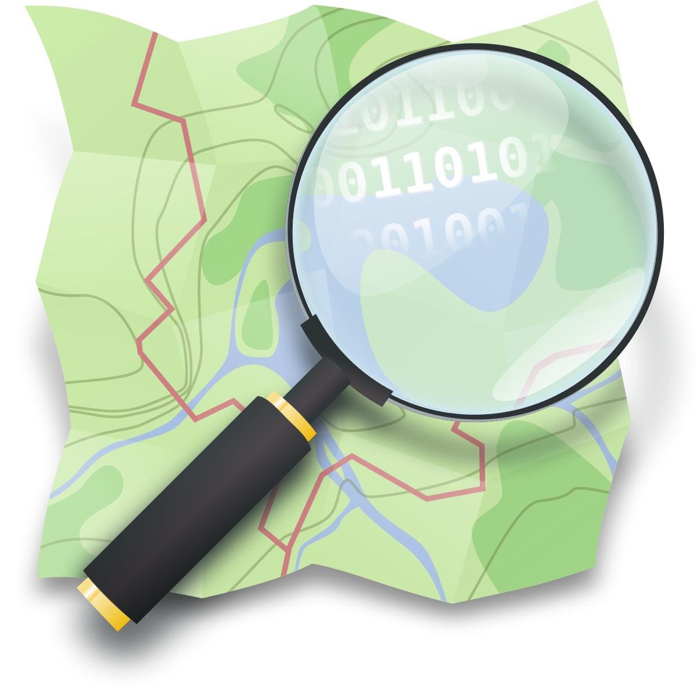


Data Sources
OpenStreetMap
Notes:
Teja: Order of these slides?
ACS: import, reliable demographic information
Fairfax county housing stock: locations of where people live in the County, distribution of housing types, etc.
OSM: crowdsourced resource kind of like google maps, updated daily, gives map of various environmental factors in different areas (s.a. restaurants, bars, parks, etc.) -- spatial wikipedia
Used this as opposed to official fairfax county mapping data because the official data did not have locations of various variables that we wanted to look at

Slide 6

American Community Survey
Bi-annual survey
5-year estimate at Census block level
Demographic and Socioeconomic data
Notes:
Notes: don't use this image

Slide 7
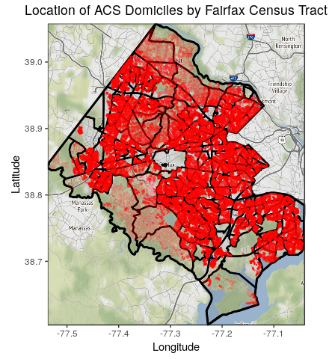
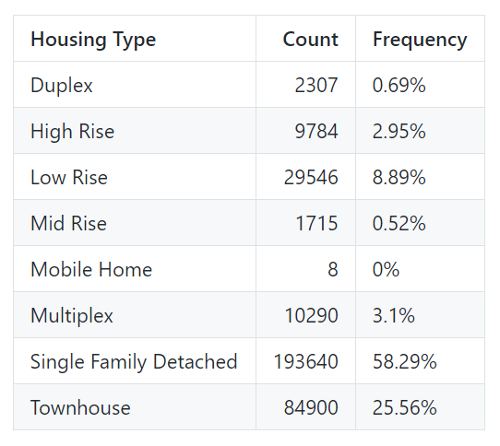
Fairfax Housing Stock Data
Synthetic population generation​
Reaggregated to Census tract, supervisor districts, and school districts​
Notes:
Make sure to introduce Graphics
Because they are geographic units of interested for the sponsor

Slide 8
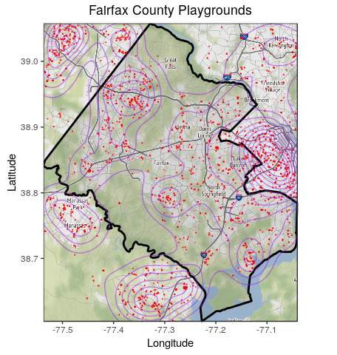
Open Street Maps: Data Discovery
Notes:
Introduce in detail what each graphic is, how it's oriented, and what the specific points, lines (contours), and areas are. Also make sure to note that this is a visualization of the spatial data we obtained from OSM.

Slide 9
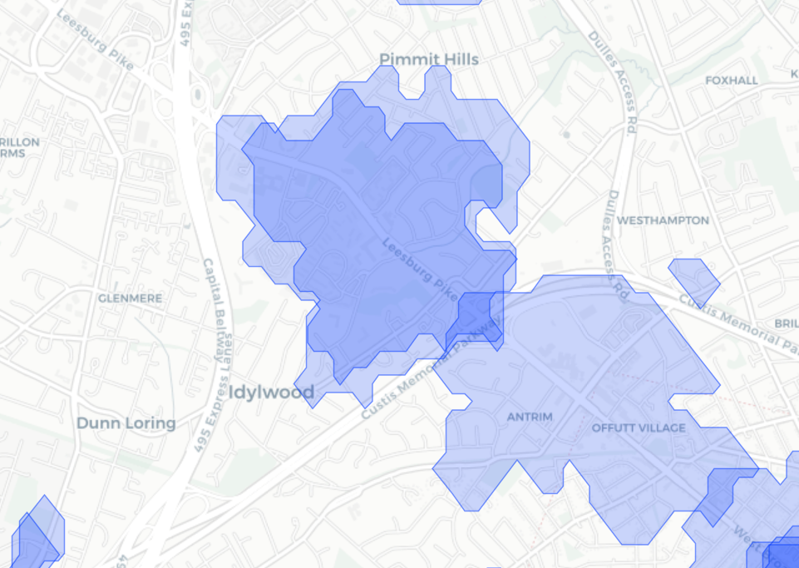
Travel Time Example
20 Minute Bus Travel Area from Supermarket
Household
Supermarket
http://rpubs.com/ccong2/508061
Notes:
Notes
Need more information

Slide 10

Index 1: Economic Vulnerability
Income
Education
Age
Race
Ethnicity
Supplemental Security Income
Public Assistance Income
English Fluency
Poverty
Commute time to work

Slide 11

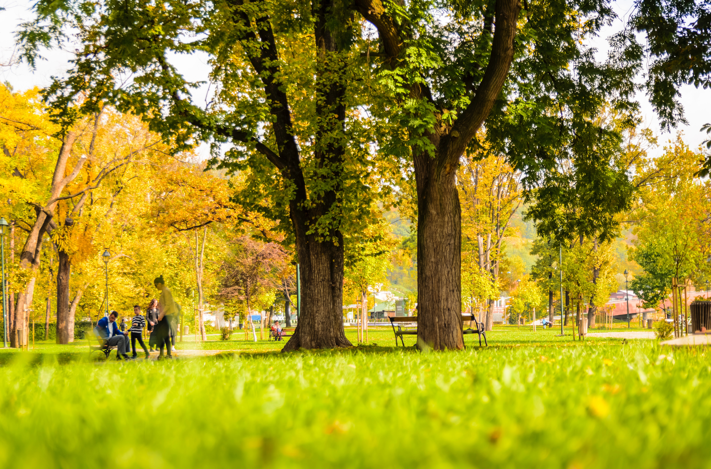
Index 2: Obesogenic Environments
Fast food
Supermarkets
Convenience Stores, Green Grocers
Restaurants
Gas Stations
Alcohol Stores, Bars, Pubs
Nature Reserves
Parks
Fitness Centers
Playgrounds
Notes:
Eliza
not ready to capture dimensionality about it yet, but Trying to capture two dimensions of this right now: food environment, physical environment;
-don't have to read all of factors

Slide 12



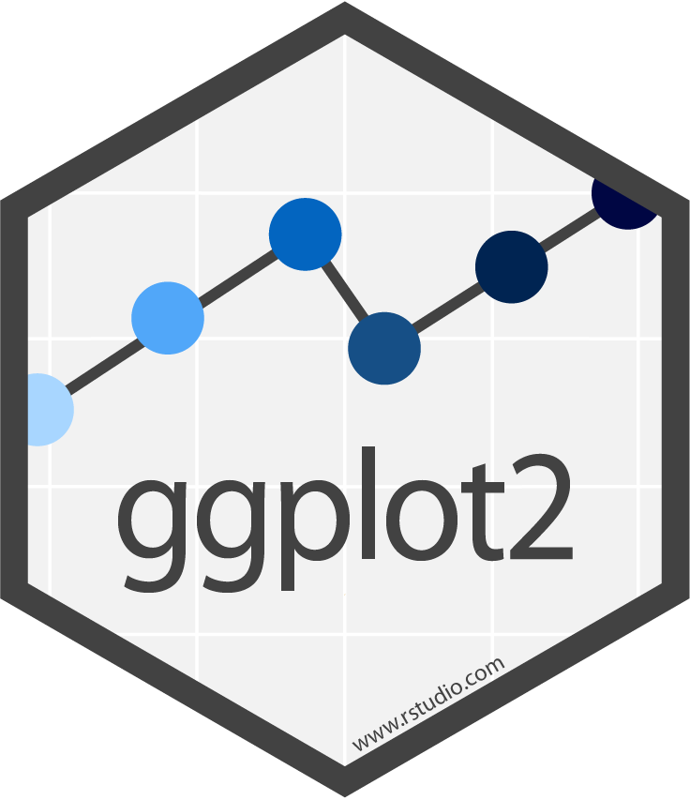

Looking Ahead
Data
Explore ACS synthetic data
Join multiple sources
ACS, Housing, OSM
Create travel-time distance
SES
https://www.tidyverse.org
Index Construction
Dimensional / Factor Analysis
Weighting & Aggregation
Interactive Visualization
Variables
Food +/-
Obesogenic
Index
Geo

